Slide 1
Immigrants, Refugees, and Human Rights
Quarter at Aggie Square
Winter Quarter 2024

Slide 2
Introductions
Professor Jeannette Money
Professor Jeffrey Kahn
Professor Mario Guerrero
Prior Aggie Square students: Lesly Contreras, Amy Saghafian, John Wei
Program Coordinator Angela Taylor
Students: name, major, interest in immigration and Quarter at Aggie Square program

Slide 3
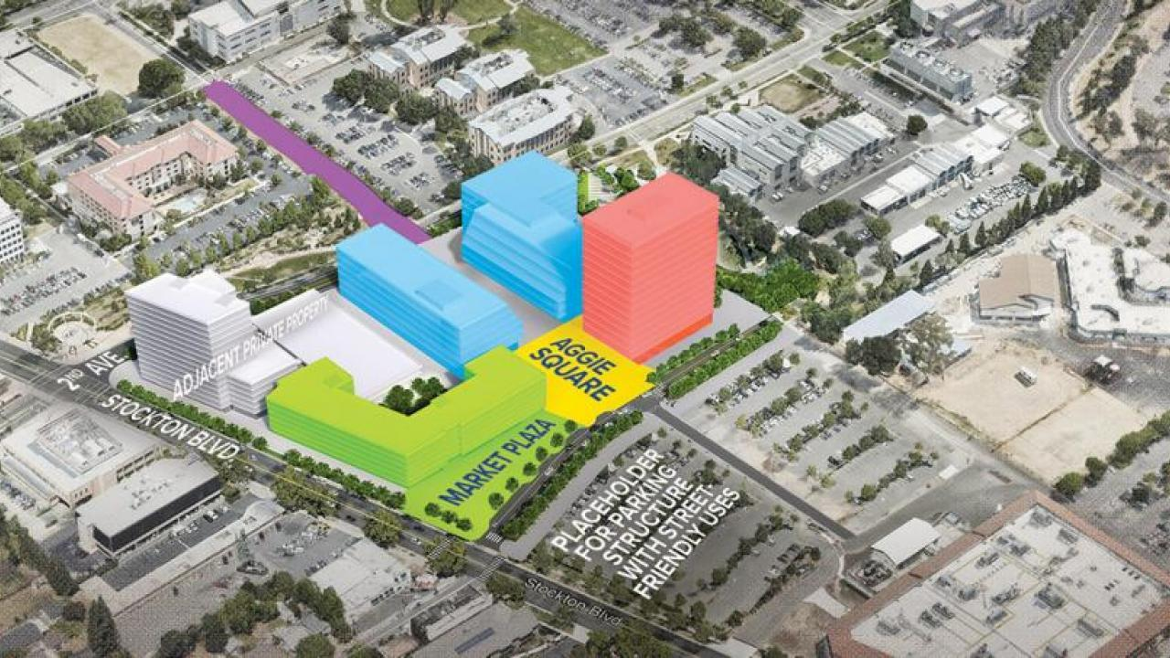
Aggie Square

Slide 4
Quarter at Aggie Square
Quarter at Aggie Square lets you engage with Sacramento in a way that enhances your education with practical experience and community engagement.
Spend a quarter with a small group of fellow students and dedicated faculty in a focused learning environment that includes classes and an internship, research, or service learning.

Slide 5
Why immigrants and refugees?
California hosts almost 11 million migrants, around 27% of the state population, and 24% of the total immigrant population in the United States.
California is now designated as a “sanctuary” state and has been a major receiving center for refugee resettlement.
However, immigrants still confront challenges in adjusting to their new lives and communities also struggle to welcome newcomers and to provide avenues for full integration.

Slide 6
Immigrants, Refugees, and Human Rights
This Quarter at Aggie Square experience combines expertise in international migration with hands-on experience working with immigrant and refugee communities to develop an understanding of the interaction between the local community and the migrants. The program goals:
develop empathy for immigrants locally and globally as well as the communities in which they settle
learn about federal, state, and local policy processes that affect immigrant reception
practice advocacy skills to improve outcomes for both immigrants and the host community

Slide 7
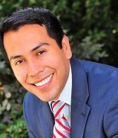
Program Team
Jeannette Money, Professor, Department of Political Science
Jeffrey Kahn, Associate Professor, Department of Anthropology
Mario Guerrero, Deputy Director, Legislation at California Department of Human Resources*
*For identification purposes only. The views or opinions expressed are those of the faculty and do not necessarily reflect the official policy or position of the organization/entity they are employed with.

Slide 8
Immigrants, Refugees, and Human Rights
When: Winter Quarter 2024
Coursework (17 units): IRE 104/SOC 104 – International Migration (4 units)
HMR 132 – Human Rights and the Refugee (4 units)
POL 104 – California State Politics (4 units)
IRE 192/POL 192 – Internship and/or Service Learning (3-6 units)
POL 198 – Group study/guest speakers (2 units)

Slide 9
IRE 104/SOC 104 International Migration
Placing local immigrant communities in global perspective
US/California/local immigration legislation
Impact of immigrants on host societies: economic, social, and political dimensions
Impact of immigrants on home societies: economic, social, and political dimensions
Immigrant integration: adaptation on the part of the migrants and the host community

Slide 10
HMR 132 Human Rights and the Refugee
Examine the emergence of the international legal regime concerning refugees (and asylees) and how it relates to “domestic” legal regimes
Examine the challenges of enforcing the refugee rights regime
Explore the experiences of those seeking refugee/asylee status
Explore case studies of resettlement
Engage critical approaches to/theories of human rights law

Slide 11
POL 104 California State Politics
The course will cover federal and state government
Focus on California government and the California legislative process
Role of interest groups in policy and politics
Role of local government
Drafting legislation
Class exercises will include: reviewing and discussing state immigration laws; attending legislative hearings; mapping a bill’s legislative process and strategizing how to get a bill signed into law; interviewing a legislator or legislative staff or interest group leader; drafting immigration legislation

Slide 12
POL 192/IRE 192 Internships/Service Learning
Work with local governmental and non-governmental organizations
Internships – onsite or distance internships
Service learning – work with governmental and non-governmental organizations on projects
Draft legislation; develop advocacy programs; organize events; tutor immigrant children; welcome refugee families; research immigration issues

Slide 13
Community collaborators
Governmental organizations: United States Citizenship and Immigration Services field office; California Department of Social Services, Refugee Programs Bureau
International Rescue Committee (IRC) – refugee resettlement agency
UC Davis Immigration Law Clinic
California Immigration Policy Center
REDA Refugee Enrichment and Development Association
California Rural Legal Assistance Foundation (CRLA)
Mexican-American Legal Defense and Education Fund (MALDEF)
SacACT: Sacramento Area Congregations Together
World Relief – refugee resettlement agency
Catholic Diocese of Sacramento – Catholic Charities

Slide 14
POL 198 Reflections/Guest Speakers
Meet members of the immigration advocacy community
The 2022 cohort met Sacramento Mayor Steinberg, Assembly Member Ash Kalra, and many community activists
Develop service learning projects
Reflect on community learning activities

Slide 15
Tentative schedule Classrooms on the UC Davis Medical Center campus in Sacramento
 | Tuesdays | Thursdays
HMR 132 | 11:00 am to 1:00 pm | 11:00 am to 1:00 pm
IRE 104/SOC 104 | 2:00 pm to 4:00 pm | 2:00 pm to 4:00 pm
POL 104 |  | 5:00 pm to 8:00 pm
POL 198 | 5:00 pm to 7:00 pm
Internships and service learning as scheduled

Slide 16
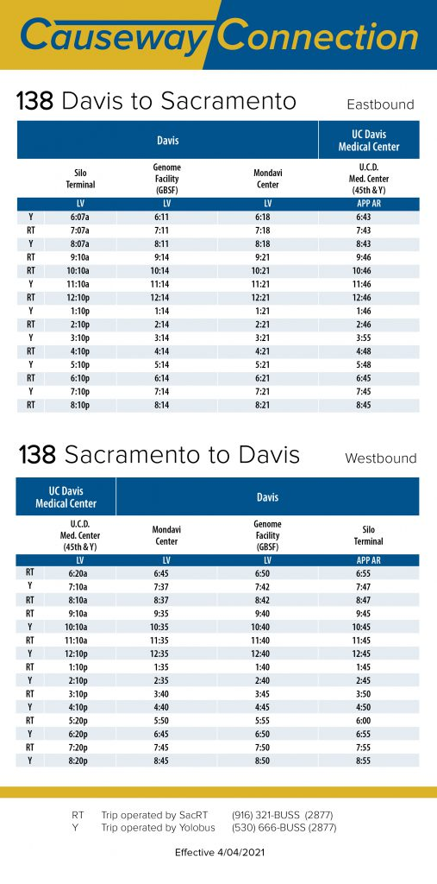
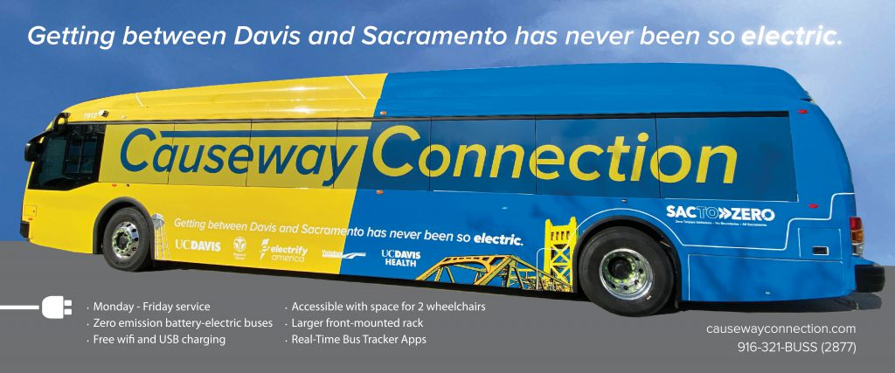
Transportation Logistics

Slide 17
Application process
Open now on the Quarter at Aggie Square website
Enrollment on a first come, first served basis for students in good standing
25 students maximum enrollment
Application deadline: Friday, October 13, 2023
Check with academic advisors to ensure you can graduate on a timely basis
Notification of acceptance by October 27, 2023 (prior to registration for Winter Quarter 2024 starting November 1)
No additional registration fees
https://qas.ucdavis.edu//immigrants-and-refugees-sacramento

Slide 18
Insights from former Q@AS students
Lesly Contreras, Amy Saghafian, Olivia Victa, and John Wei

Slide 19
Amy Saghafian
Participating in the QAS program last Winter was one of the best decisions I have made throughout my undergraduate career.
Studying refugees and global migration flows in Dr. Money’s courses while simultaneously working with the refugee population in my local community as part of the internship component allowed me to apply my work experiences to the topics we were learning in class. Completing the biweekly internship reflections pushed me to analyze my work more deeply and helped me make the most out of my work. I also really enjoyed hearing about my classmates' internship experiences, especially considering we all worked with different organizations and different sectors of the immigrant/refugee populations in Sacramento and Davis.

Slide 20
Amy Saghafian
Further, Professor Guerrero’s course made me much more familiar with how California’s government works. The final project, which involved drafting a Bill for the California constitution, taught me step by step how to get a Bill passed into law. After completing the project, I feel confident enough to amend or draft a real Bill, which is a great skill that all California residents should have.
My favorite part of the program was the guest speakers. It was beyond helpful to hear the different experiences of people who work for U.S. government agencies, local non-profits, and the California government, and it gave me ideas and options for different types of work I can do after graduation.
The QAS program was without a doubt the highlight of my undergraduate experience. If you are interested in getting hands-on experience with learning more about Refugees, human rights, migrations flows, and California’s government system, I definitely recommend participating in the program.
If anyone has any questions about the program, I would be happy to answer them and chat with you about it. Feel free to reach out to me via email: alsaghafian@ucdavis.edu

Slide 21
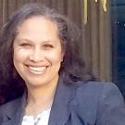
Administrative Support
Angela Taylor qas@ucdavis.edu
The Quarter at Aggie Square office will enroll accepted students in all coursework
What happens if you have already taken one of the classes in the program?

Slide 22
Questions

